Slide 1
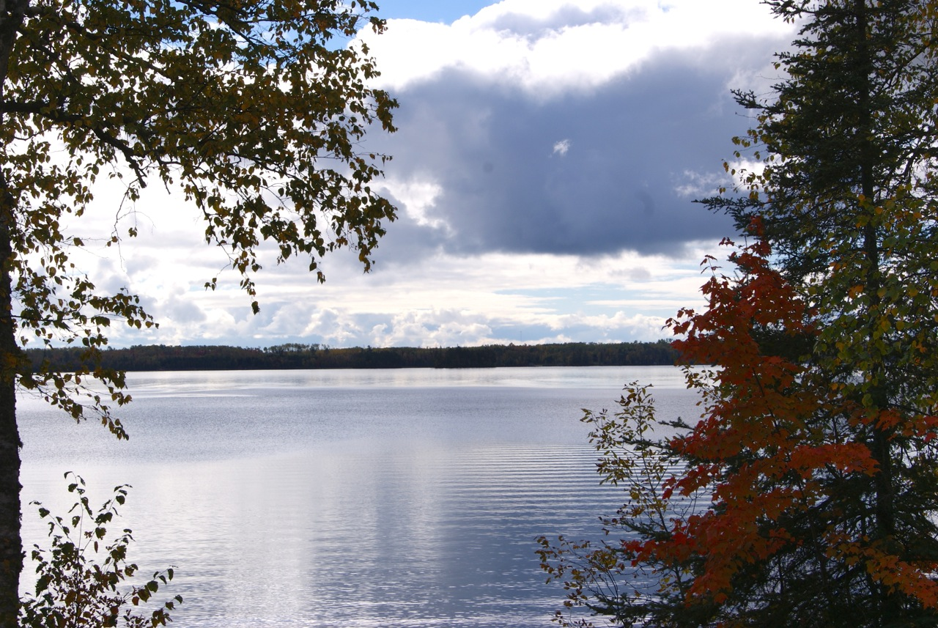

Slide 2
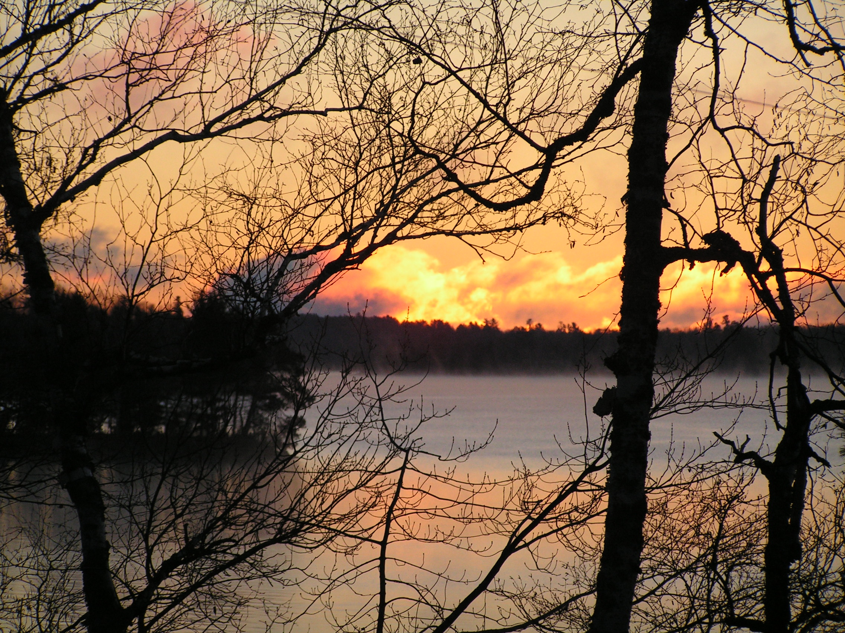

Slide 3
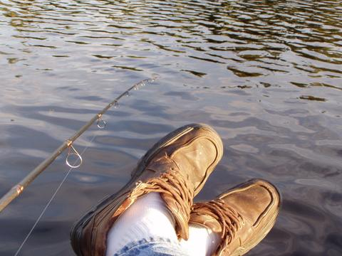

Slide 4
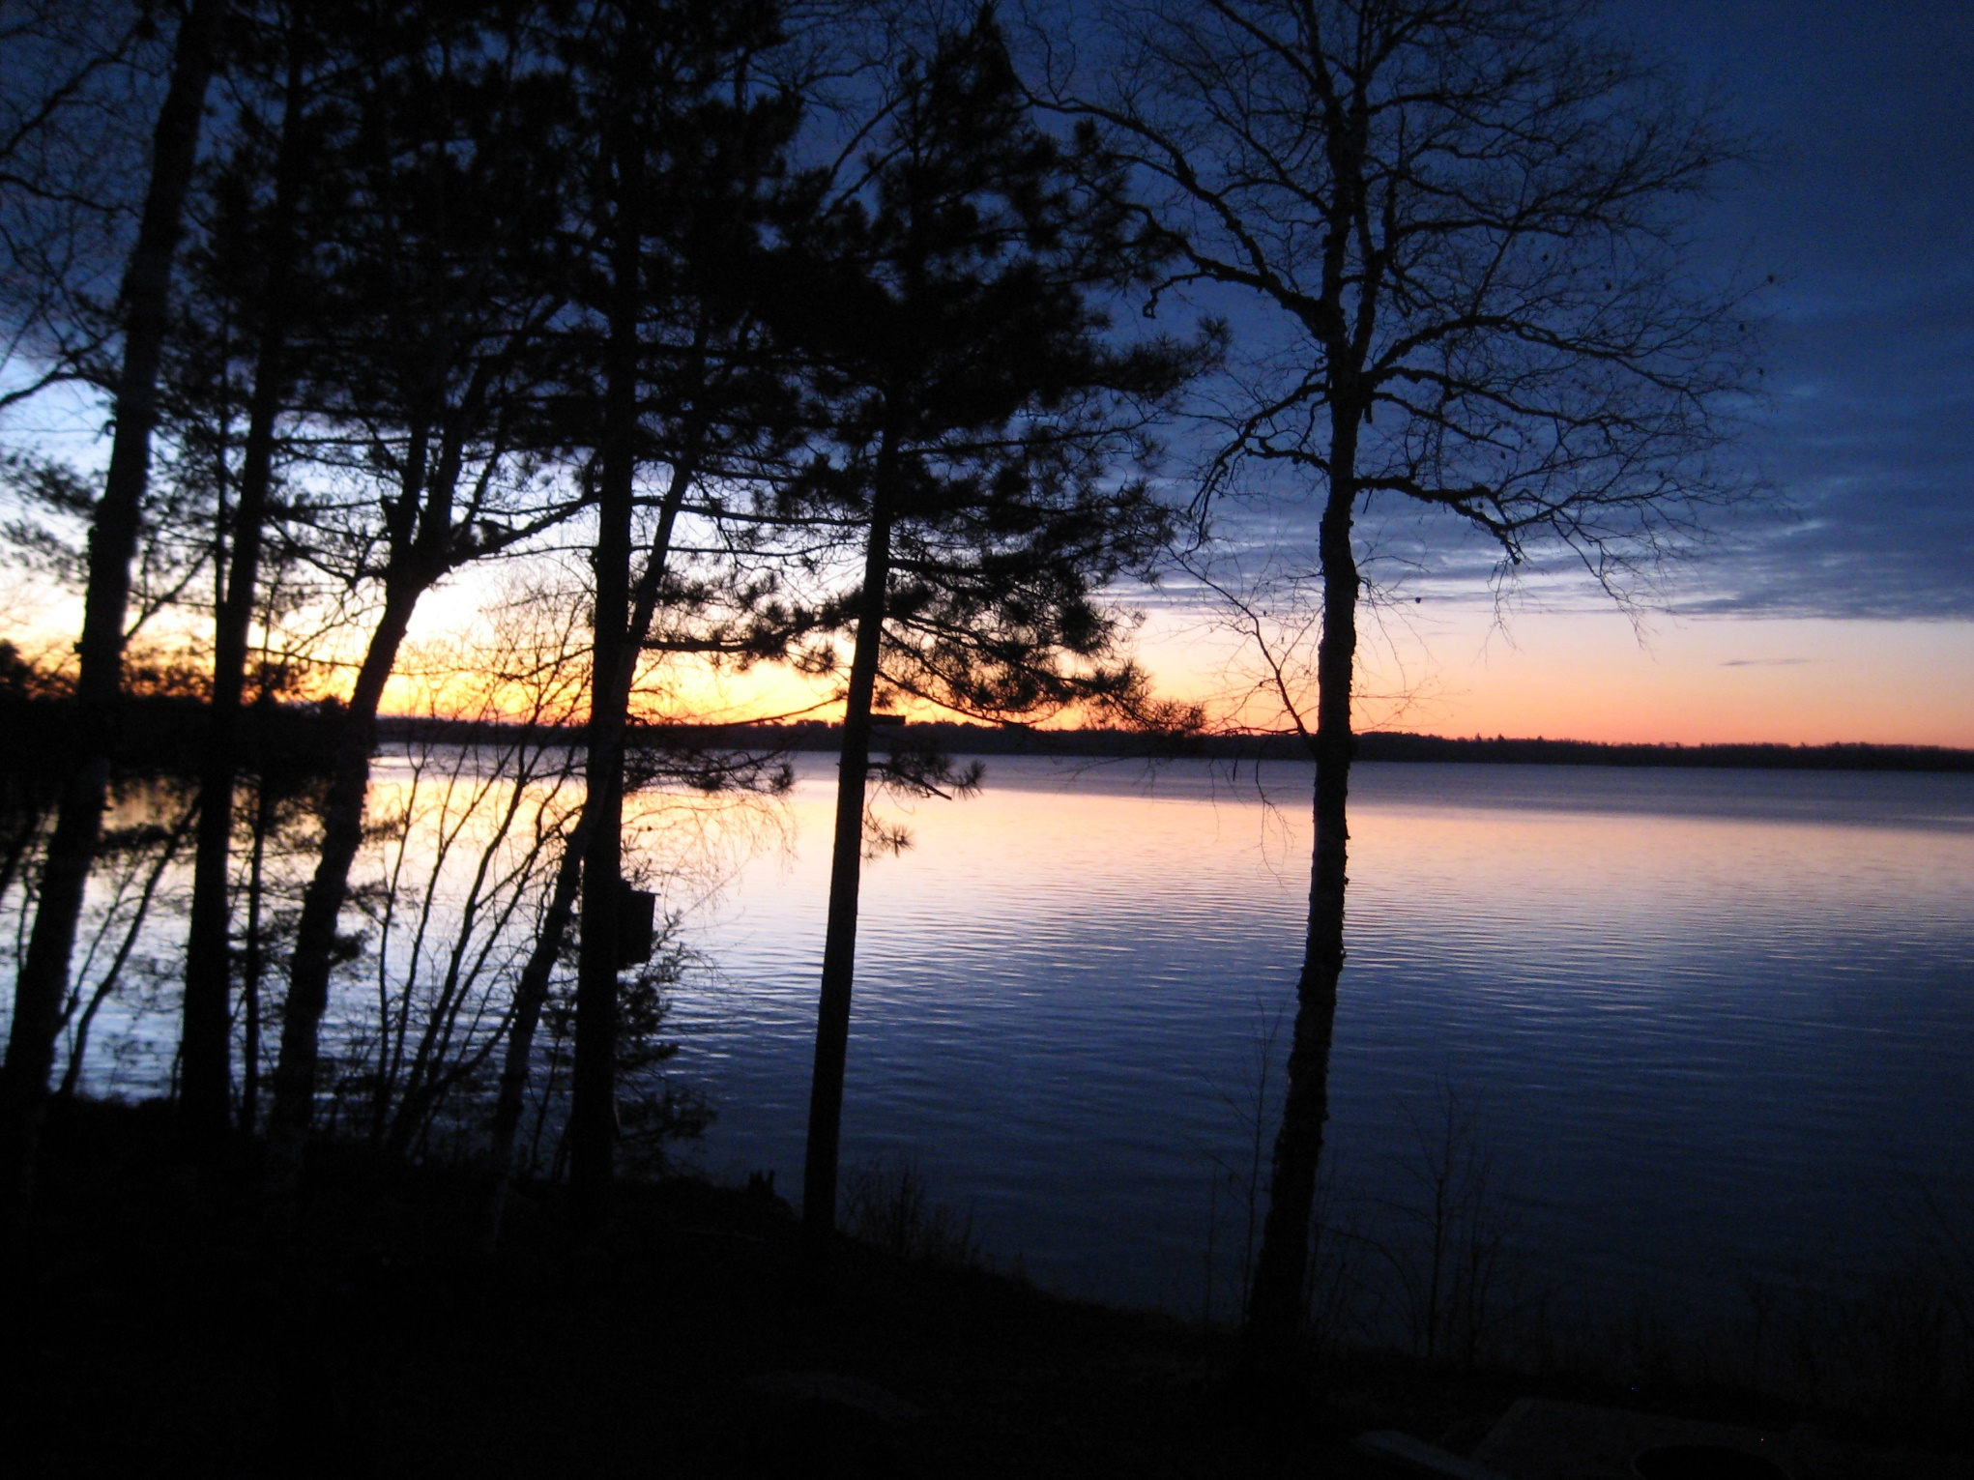

Slide 5
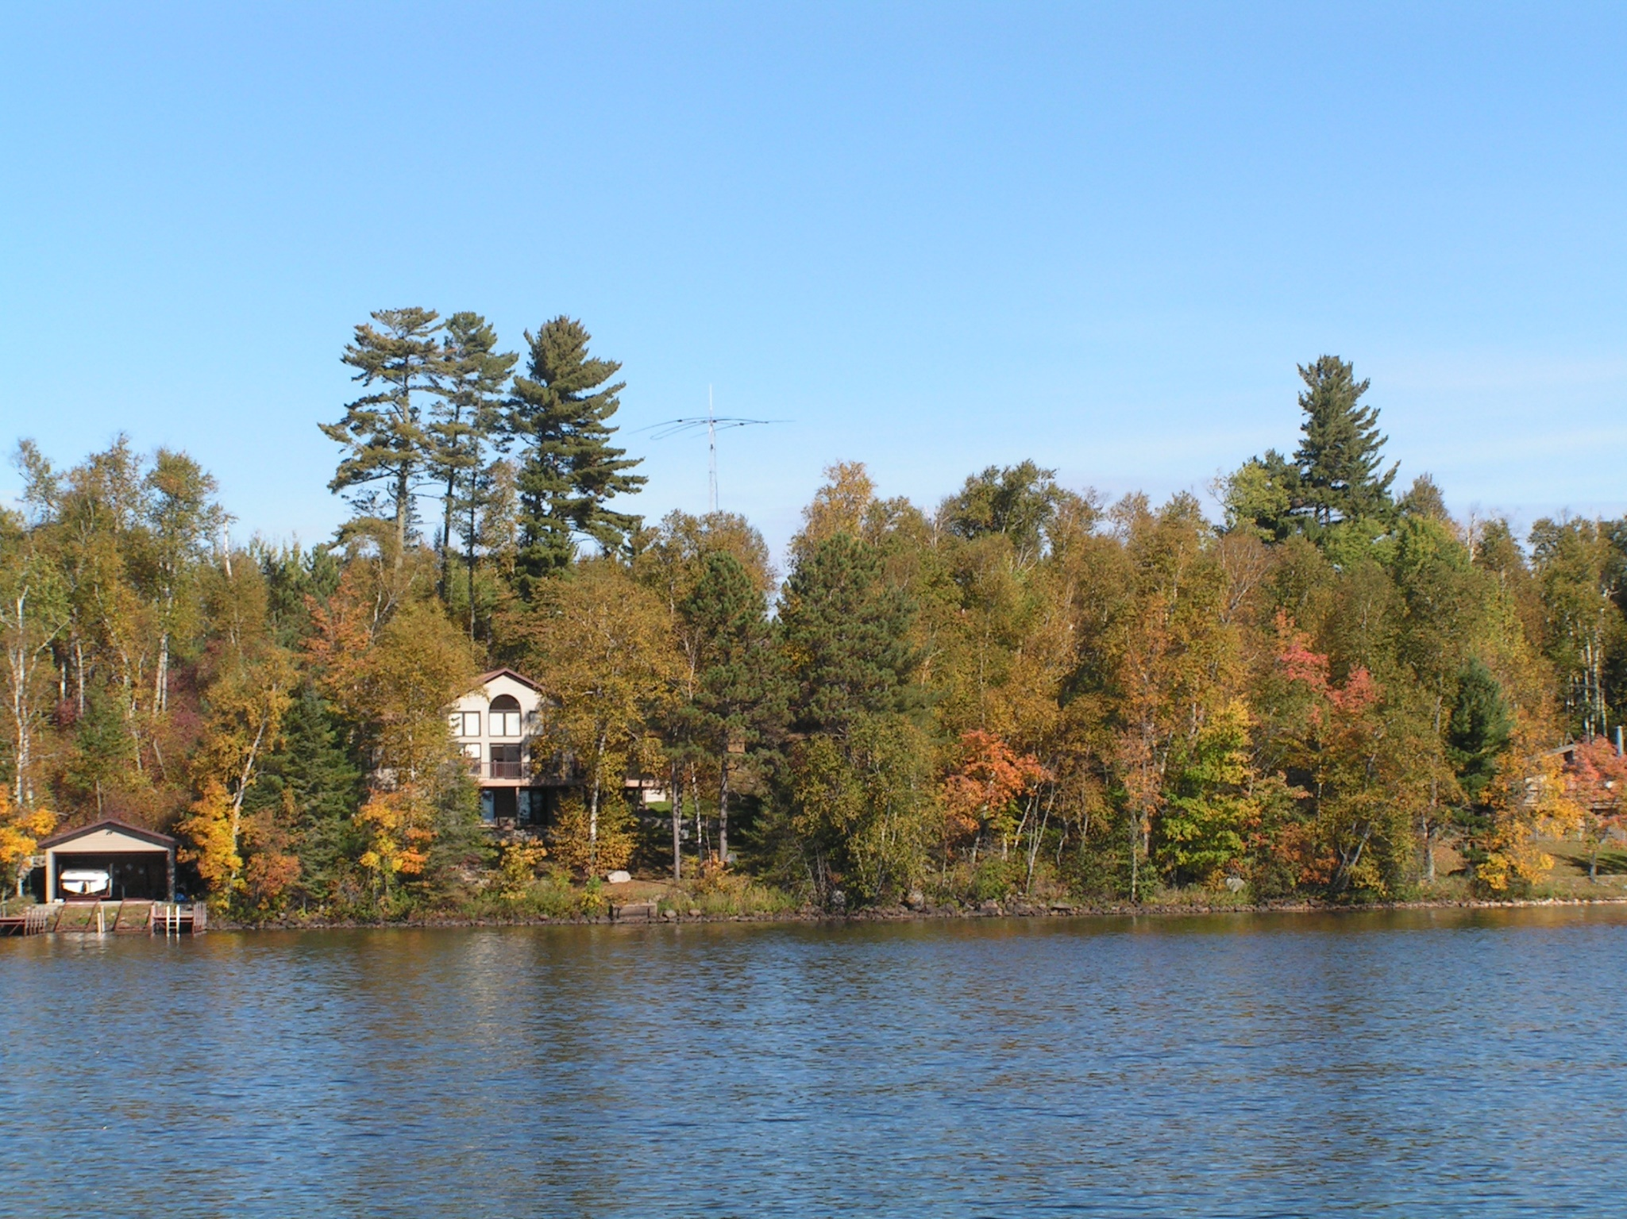

Slide 6
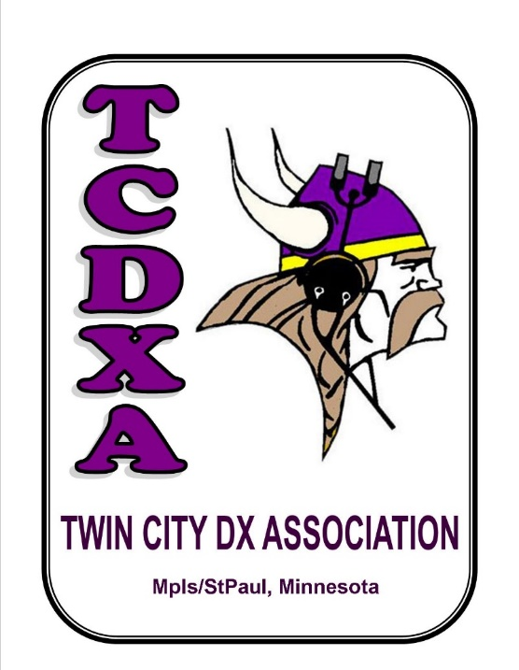


The Antenna Restricted DX-er
Rick Borken KØXB
k0xb@arrl.net
San Diego DX Club, February 24, 2016

Slide 7
We live on Lake Vermilion, which is a large and beautiful lake in northern Minnesota.
This is the view from my QTH. (You can find me in my fishing boat a lot.)

Slide 8
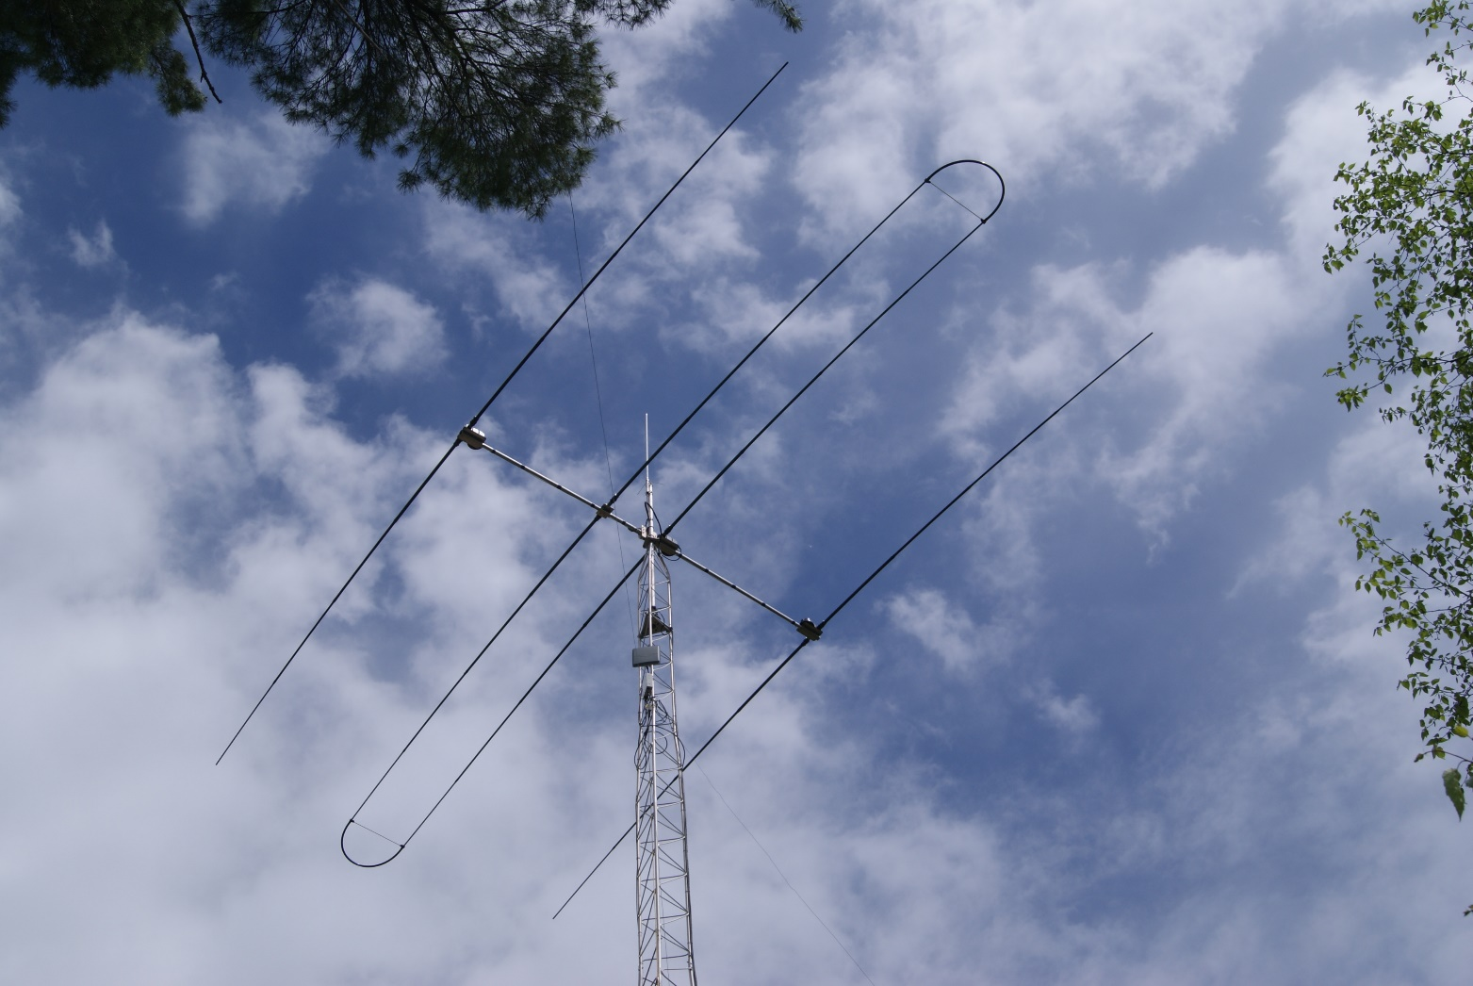
Since I retired, I’ve put together the best station I’ve ever had. Why leave Minnesota?

Slide 9
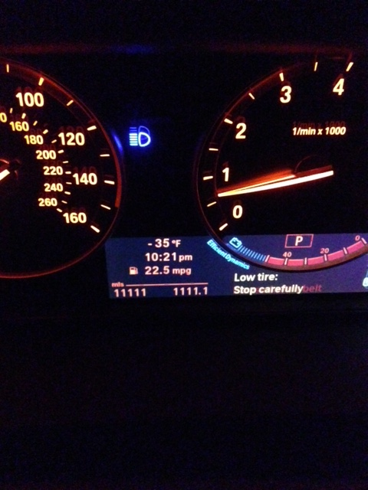
This was New Year’s Eve 2014.
Now, we spend New Year here.

Slide 10

Tonight’s Presentation
I’ve successfully worked DX, using a small,
temporary station and a 12’ vertical antenna
in a small city lot.
My results – 225 countries and counting (and all 40 zones too)
My antenna, and the rest of the station
My operating Hints and Tricks, some of them

Slide 11
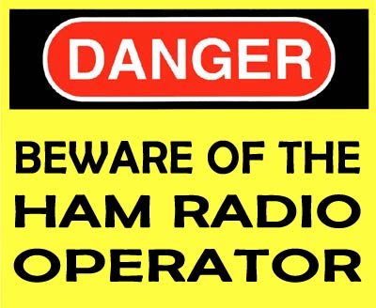
Lots of Constraints:
Rented house, so nothing permanent
Small back yard (25’ or less on the diagonal)
Dense neighborhood
Only 115v available (so no amplifier)
Want to maintain a low profile from the neighbors
Size, weight limitations
All I really wanted was to enjoy ham radio and
work a few DX countries.
Maybe I’d learn something too.

Slide 12
Results – by mode
MODE | Countries worked | Countries confirmed
Mixed | 225 | 206
CW | 206 | 182
Digital | 149* | 134
SSB | 123 | 101
*Mostly RTTY.
See next slide for
break-down.
I’ve worked 225 countries - more than 200 over the past five years (twenty months) - all with 100W or less and a simple vertical. For eight years in a row, I’ve worked more than 100 countries from here.

Slide 13
Digital Break-down
Mode | Last Five Years % | Last Two Years %
RTTY | 90% | 71%
JT65 and JT9 | 45% | 60%
PSK | 47% | 11%
Looking just at Digital QSOs, the overwhelming majority of countries were on RTTY.
But over the last two years, JT65 and JT9 have gotten much more popular.

Slide 14
Results by Band
# of
countries
80m 40m 30m 20m 17m 15m 12m 10m
I’m not surprised most QSOs have been on 20 through 10 meters.
I think it’s amazing I worked anything on 80m.

Slide 15
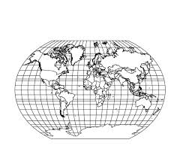
“Specials”
It’s a thrill to work rare (or at least semi-rare) DX with my simple station. Some examples include:
India Desecheo Rotuma
  Spratly Franz Josef Togo
  Mauritius Willis Burundi
  Timor-Leste Ducie Lord Howe
  Juan Fernandez Navassa Reunion
  Clipperton Lesotho Minami Torishima
  Wallis & Futuna Malpelo Brunei
  Mauritania Togo Malawi
  D.R. of the Congo The Gambia Armenia
  Liberia Austral Mongolia
  W. Sahara Sao Tome Cocos
  S. Shetland Chagos Laos
  Vanuatu Tokelau Chatham
  S. Georgia Palmyra Temotu

Slide 16

How far away?
I’ve worked Reunion five times and Mauritius once. They are more than 11,500 miles away.
But, I have at least nine QSOs which could have been long-path.

Slide 17
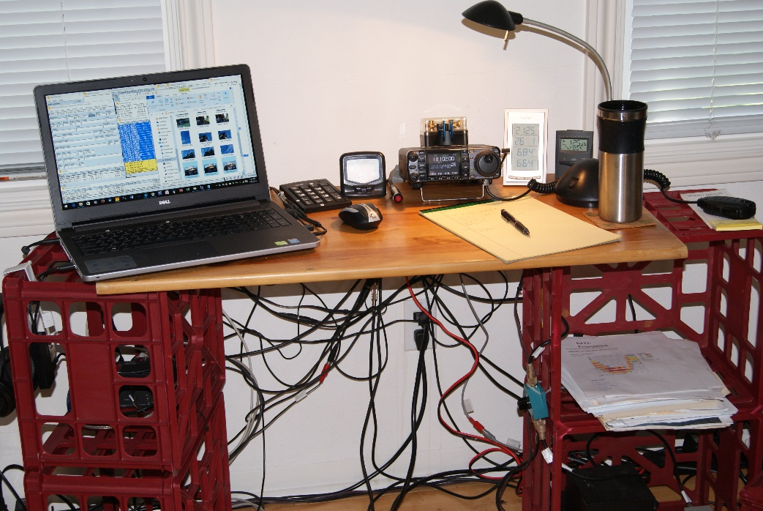
My Station
It all fits in two milk carton crates:
  Icom IC-7000 XCVR and accessories
    100 W max, less on PSK, JT65 and JT9
    Narrow filters on CW and RTTY
    Big coffee cup and lots of tangled wires
I label all cable ends and keep an accurate wiring diagram.
  I can be up and running in less than an hour.
The real key is the antenna, of course.

Slide 18
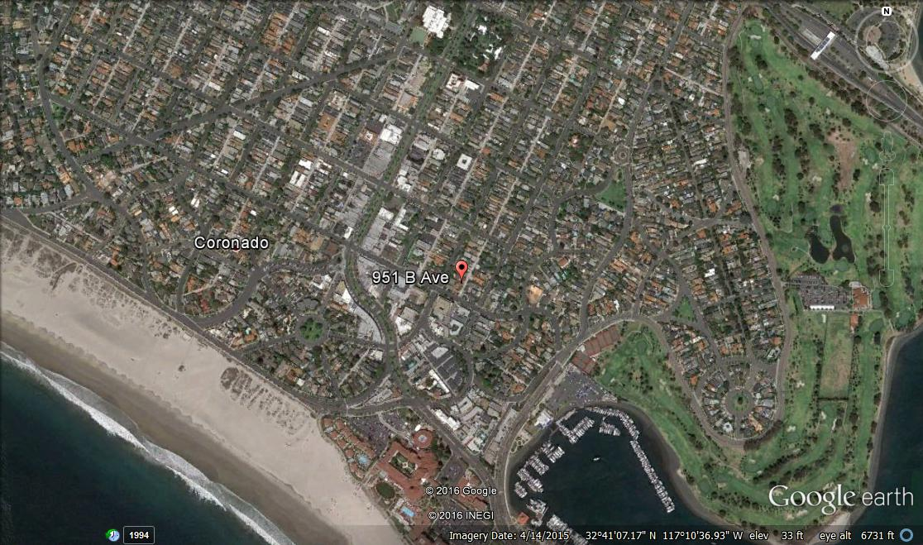
The KØXB/6 QTH
The antenna is on a tripod in the back yard, with larger houses next door.
I’m a third of a mile from the coast.
Maybe that helps.
My QTH

Slide 19
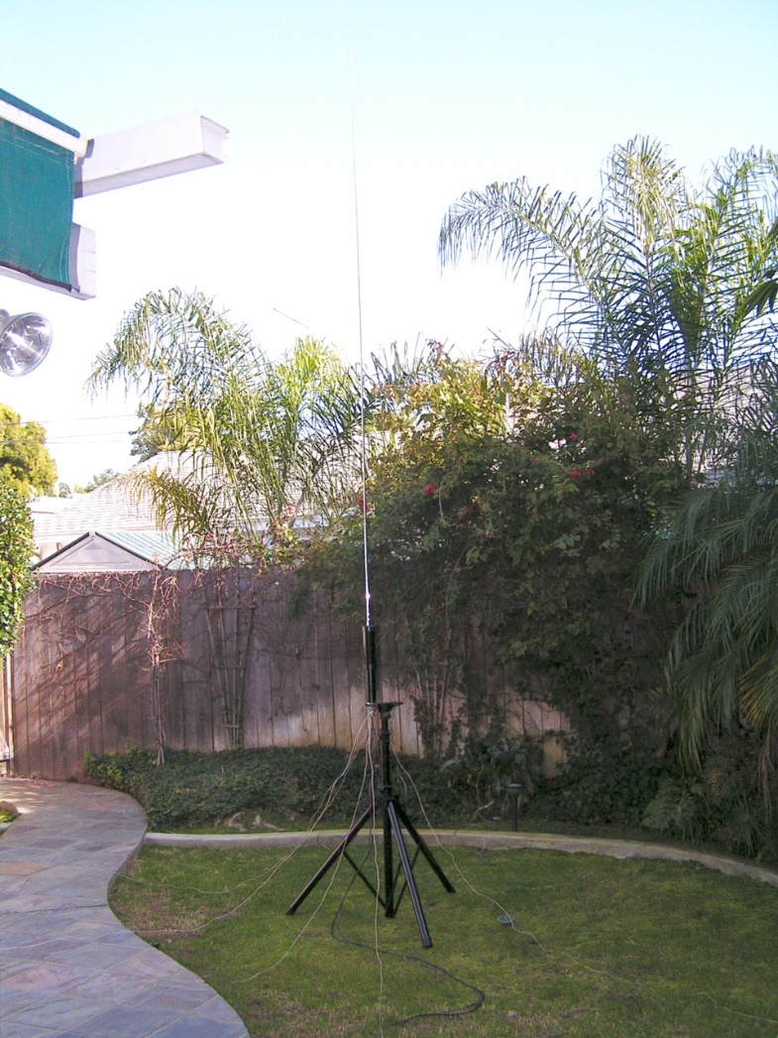
My antenna is a mobile motorized coil (a High Sierra “Sidekick”) mounted on a portable tripod, with a 12’ telescoping whip.
There are eight radials of varying lengths on the ground. It’s fed with 100’ of RG8-X and a 12v control line.
I can put it up and take it down in minutes. An MFJ-259B antenna tuning meter helps a lot.

Slide 20
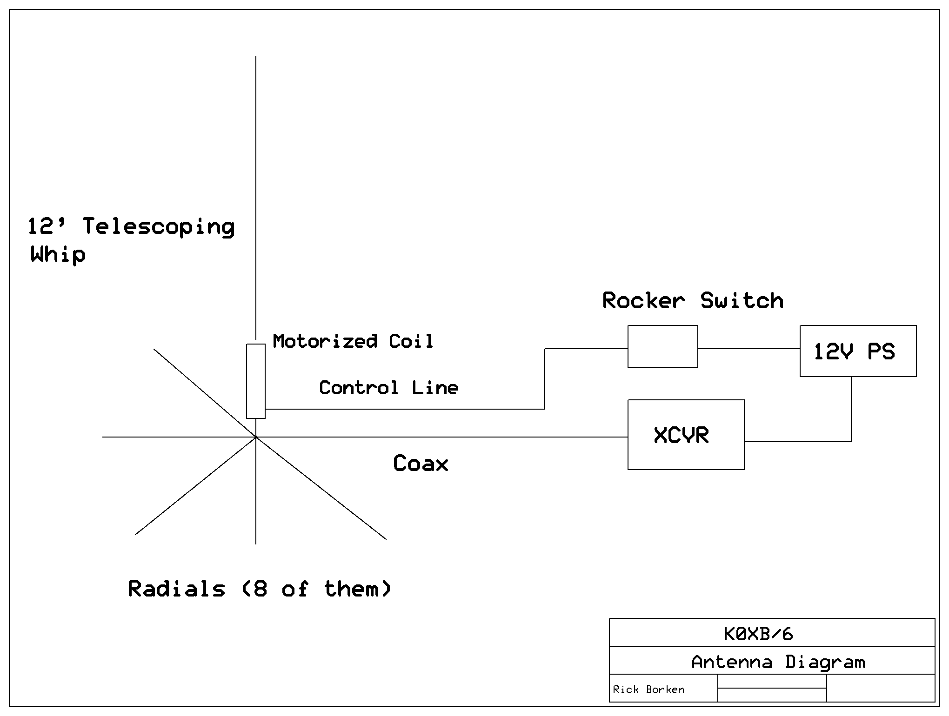
Antenna Diagram
With the 12’ whip fully extended, the antenna is resonant on 20m. It can be tuned for 30, 40 or 80 by using the coil. Shortening the whip tunes the system for 17, 15, 12 and 10.

Slide 21
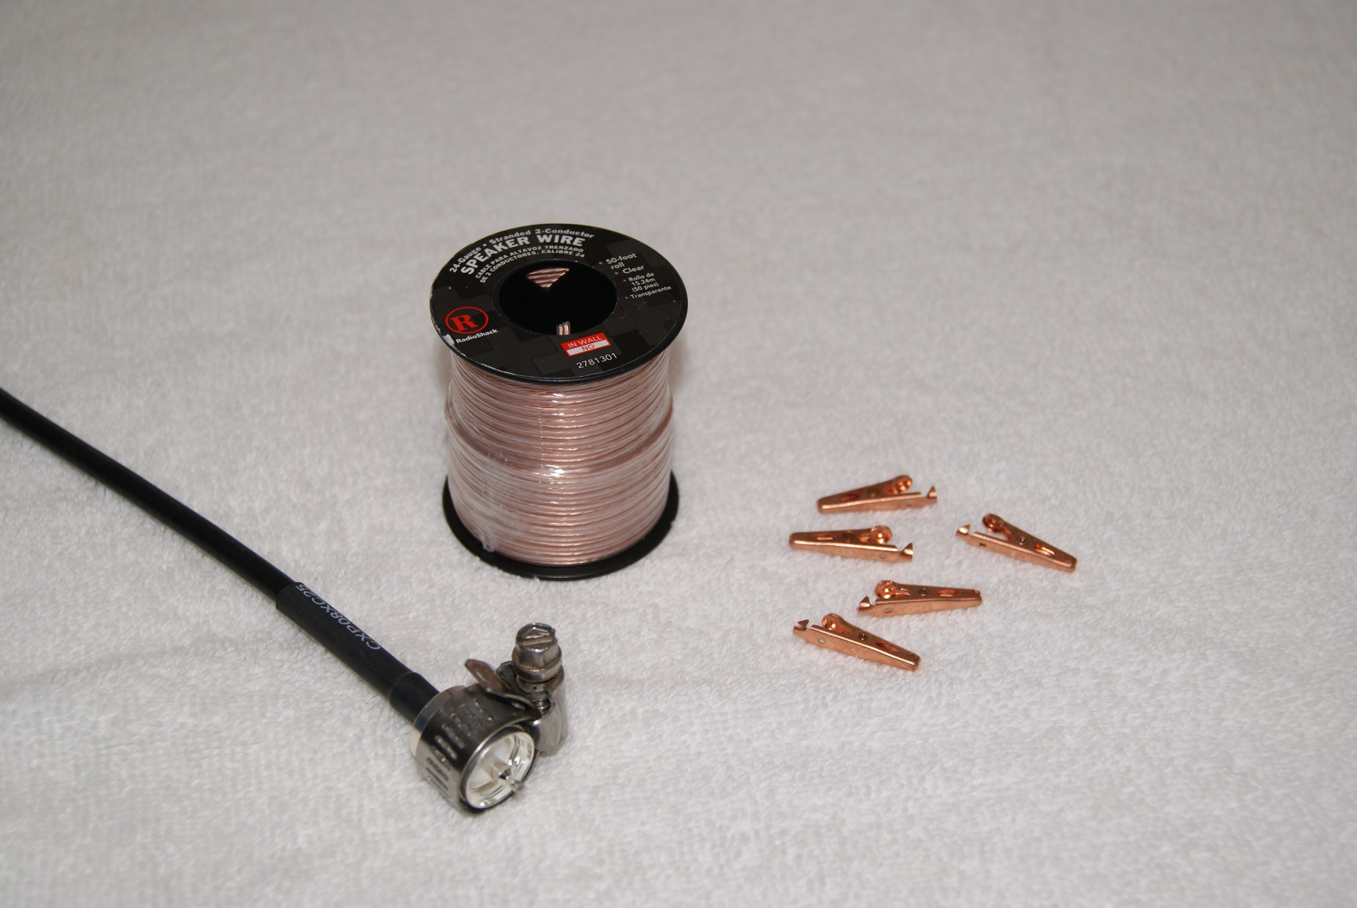
Radials
I cut a 100’ roll of 24g flexible speaker wire into four 25’ sections. With alligators clips soldered to one end, I spread the wires apart from the other end.
This gave me eight 25’ radials. They clip to the tag end of a hose clamp on the coax connector at the base of the coil.
I spread them out on the lawn at 45° intervals, (and pull them in when the gardener shows up).

Slide 22

Operating Hints
CW and RTTY account for 95% of the countries I’ve worked.
Take advantage of DX Contests. They want to work you, and there are many DX stations on the air during major contests.
RTTY is only active during a contest, but it is very active.
Use your logging program together with the cluster to alert you to new ones. This is a great tool.
“KØXB/6” works better than “KØXB” on CW.

Slide 23
Use Your Time Wisely
“Time is an illusion.”
- Albert Einstein
  If the bands are dead, do something else.
  But don’t give up if the DX signal is weak…call them if you can hear them.
  Wait for the pileups to thin out and favor the west.
  Sunset and sunrise are full of surprises
  Being retired helps

Slide 24
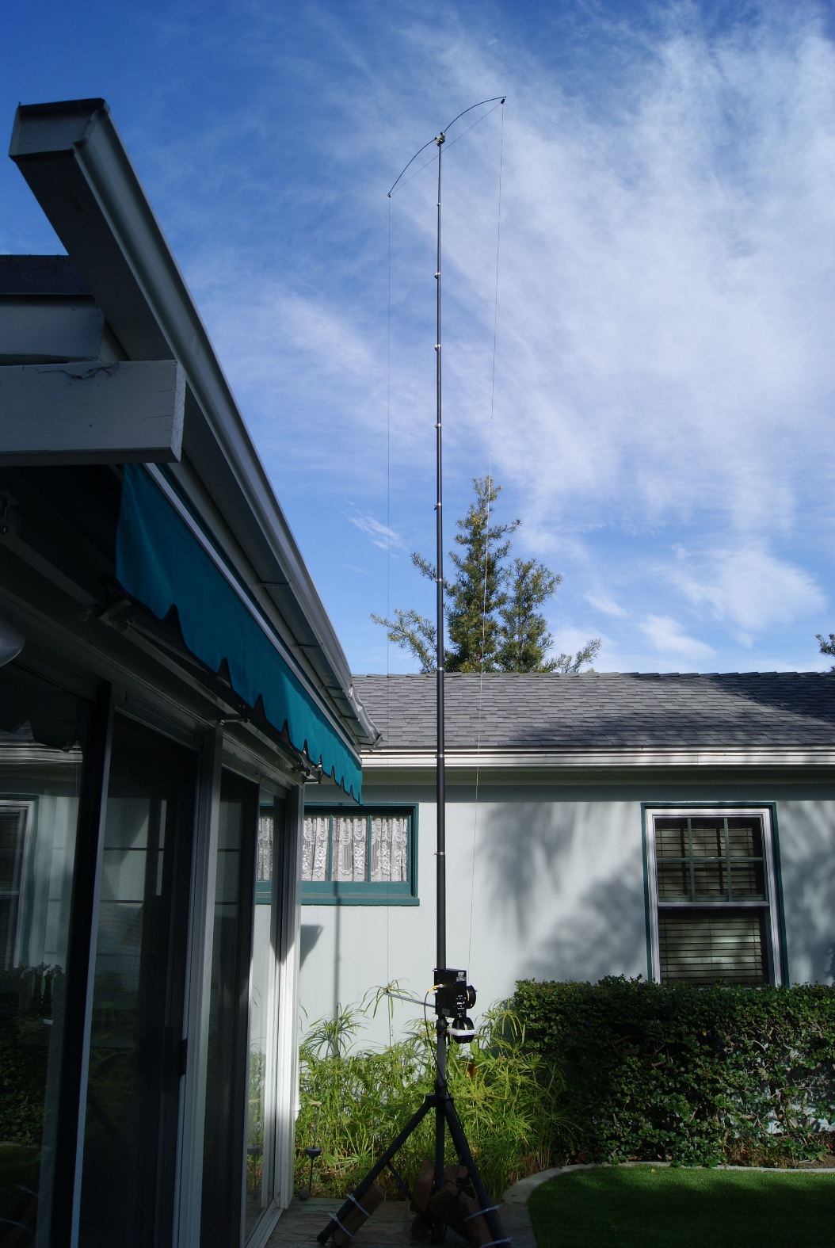
It’s a New Day
My trusty antenna started to fail…so I bought a CrankIR.
I’ve been using it for two months, and I am impressed.
The results remain to be seen, but so far it seems to be at least as good as my old antenna.

Slide 25
Thanks!
I hope you can tell how much I enjoy this wonderful hobby. It seems to me that’s the whole point – to learn new things, to challenge yourself and have fun.
73

